Slide 1
Capstone Project
Mobile Price Range Prediction
Abhijeet Singh

Slide 2
Predicting the mobile price range
Problem Statement
Data Overview and preprocessing
Exploratory Data Analysis
Feature Engineering
Model Implementation
Hyperparameter Tuning
Model Evaluation Metrics
Conclusion

Slide 3
Problem Statement
In the competitive mobile phone market companies want to understand sales data of mobile phones and factors which drive the prices.
The objective is to ﬁnd out some relation between features of a mobile phone (eg:- RAM, Internal Memory, etc) and its selling price. We do not have to predict the actual price but a price range indicating how high the price is i.e. 0 (low cost), 1 (medium cost), 2 (high cost), 3 (very high cost)

Slide 4
Data Overview
Battery_power: Total energy a battery can store in one time measured in mAh
Blue: Has Bluetooth or not
Clock_speed: speed at which microprocessor executes instructions
Dual_sim: Has dual sim support or not
Fc: Front camera megapixels
Four_g: Has 4g or not

Slide 5
Data Overview cont.
Int_memory: Internal memory in gigabytes
M_dep: Mobile depth in cm
Mobile_wt: Weight of mobile phone N_cores: Number of cores of processor
Pc: Primary camera megapixels Px_height: Pixel resolution height

Slide 6
Data Overview cont.
Px_width: Pixel resolution width
Ram: Random Access Memory in megabytes
Sc_h: Screen height of mobile in cm
Sc_w: Screen width of mobile in cm
Talk_time: Longest time that a single battery charge will last
Three_g: Has 3g or not

Slide 7
Data Overview contd.
Touch_screen: Has touchscreen or not
Wiﬁ: Has wiﬁ or not
Price_range: This is the target variable with value of 0(low cost), 1(medium cost), 2(high cost) and 3(very high cost).

Slide 8

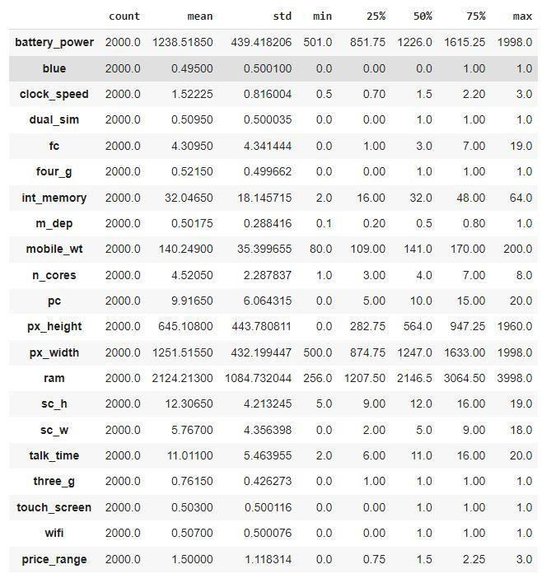
Preprocessing
On Observing the data, it was found out that:
Px_height (pixel height) and sc_w (screen width) have some values equal to 0.
So replaced those values with the median values of their respective columns.

Slide 9
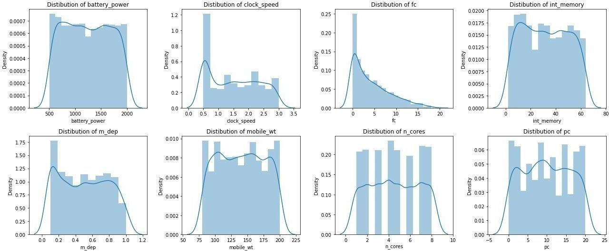
EDA
Univariate Analysis
Distribution of features:

Slide 10
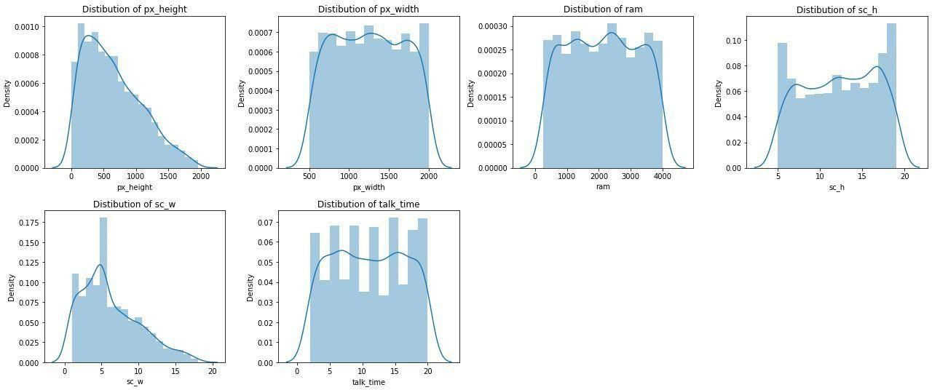
EDA
Univariate Analysis contd.
Distribution of features:

Slide 11
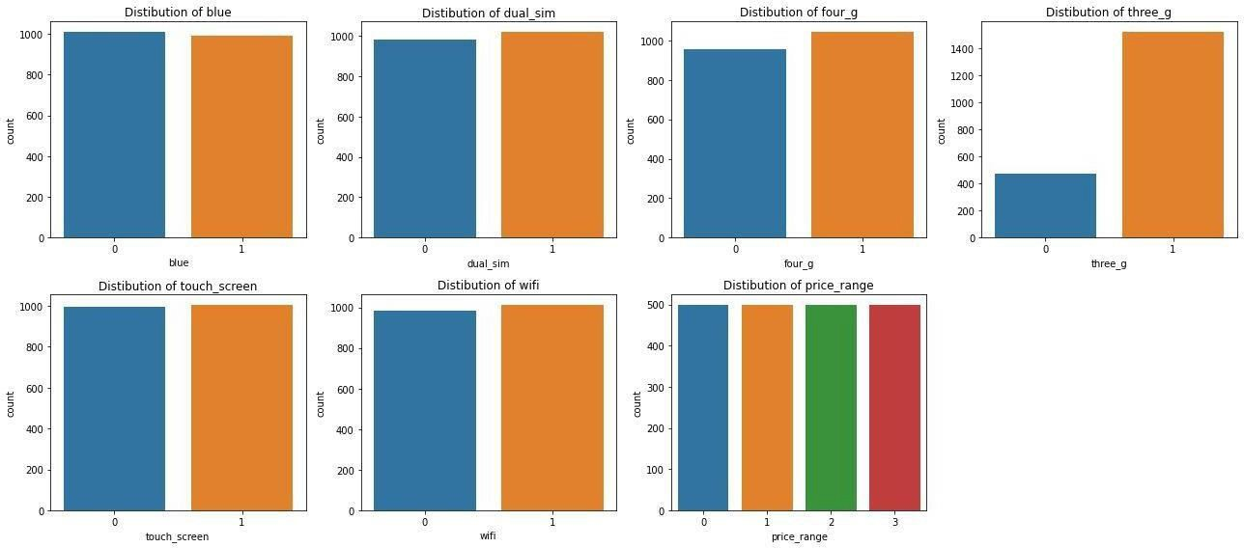
EDA
Univariate Analysis contd.
Distribution of features:

Slide 12
Univariate Analysis contd.
EDA
Conclusion:
Most of the phones currently available in the market have 3G support.
There is a similar count of records for phones belonging to all price ranges in the given data.
Most of the don't contain front camera or having low quality cameras.

Slide 13
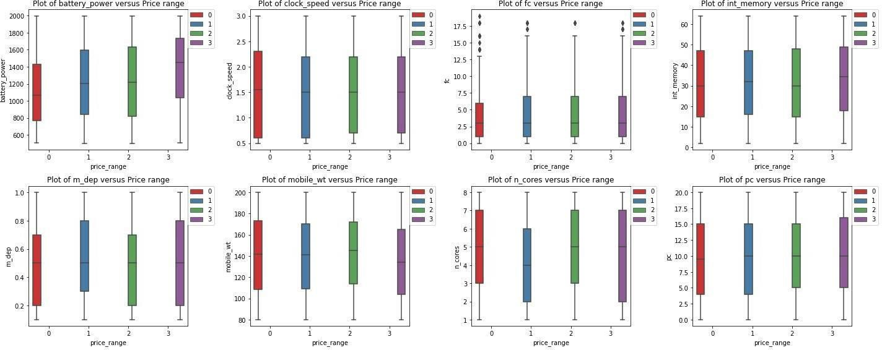
EDA
Bivariate Analysis
Effect of Target variable on features:

Slide 14
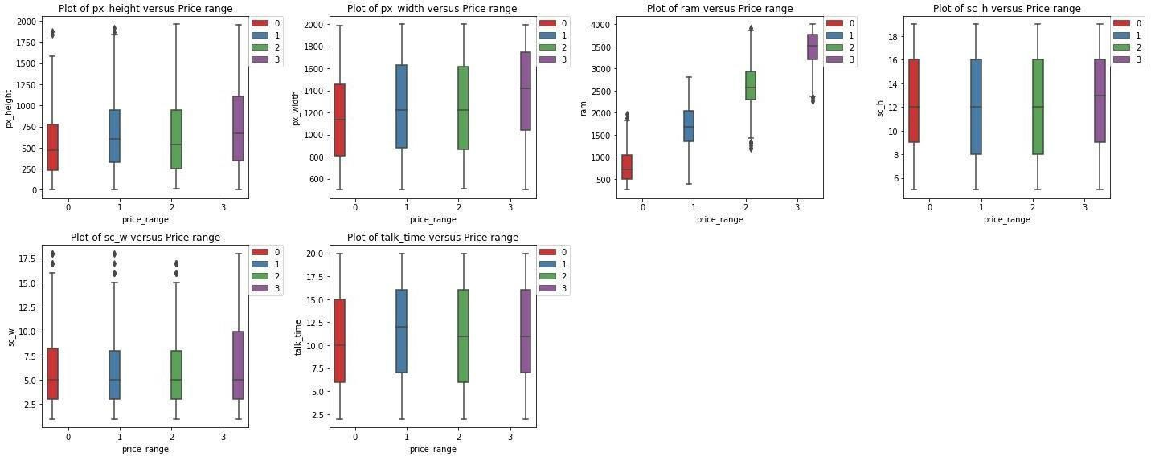
EDA
Bivariate Analysis contd.
Effect of Target variable on features:

Slide 15
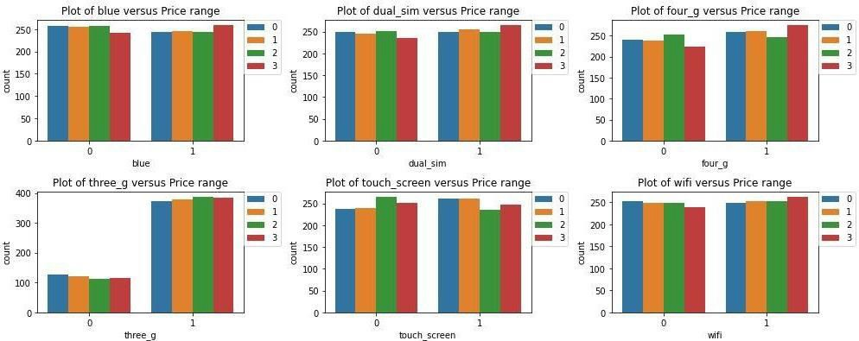
EDA
Bivariate Analysis contd.
Effect of Target variable on features:

Slide 16
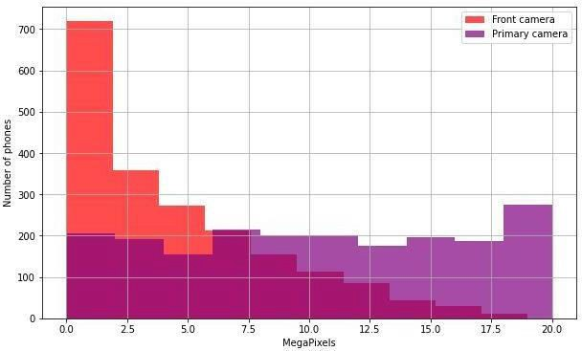
EDA
Multivariate Analysis
Effect of Primary and front camera on phones:

Slide 17
Conclusion:
EDA
Relatively expensive phones have higher capacity batteries.
Most Expensive (category 3) phones have better cameras.
Relatively expensive phones have much bigger RAMs.
Expensive phones have better screen quality.
Most Expensive phones have wider screens.
Most Expensive phones are lighter than competition.

Slide 18
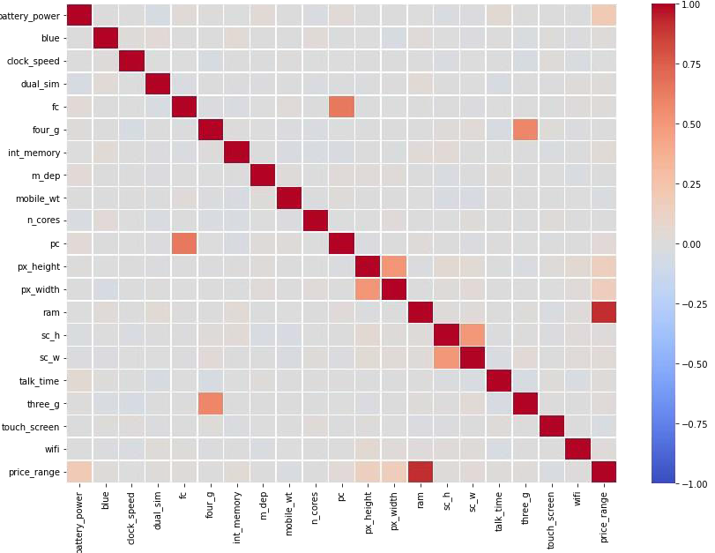
Feature Engineering
Checking for multicollinearity:

Slide 19

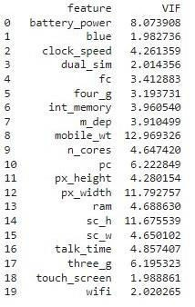
Feature Engineering contd.
Checking for multicollinearity using VIF score:

Slide 20

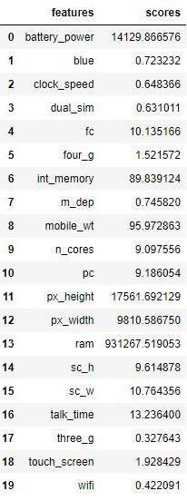

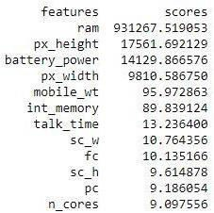

Feature Engineering contd.
Using SelectKbest method with ‘chi2’ as scoring function for feature selection:

Slide 21
Model Implementation
Following Models were implemented:
Logistic Regression
Random Forest
XGBoost

Slide 22
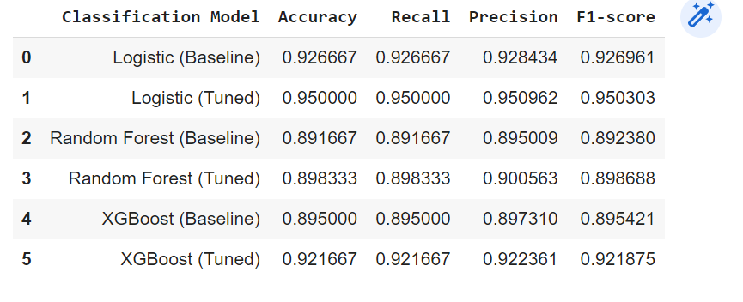
Model Implementation contd.

Slide 23
Model Selection
Observations:
Logistic Regression, XGBoost gained the most from tuning.
Logistic Regression, best performing models getting accuracy of 95% (after tuning), followed by XGBoost having accuracy 92.8% (after tuning).

Slide 24

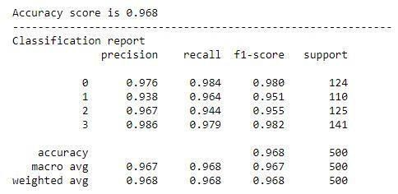
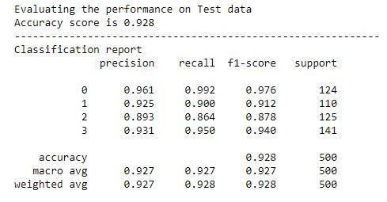
Model Selection contd.
Logistic Regression
XGBoost

Slide 25
Conclusion
After evaluating the performance metrics of all the models, we have come to the conclusion Logistic Regression are the best models for this case.
The important features in determining price range of a mobile phone were: RAM, battery power, pixel height and pixel width.
But the most important feature which single handedly affects the price range is RAM as can be seen from the selectkbest score and feature important graphs.

